Slide 1
ETP Process up to USARJ Commander
Projected Milestones
USARJ Commander (NLT 10 Days prior)
COVID Steering Committee (NLT 15 Days prior)
COVID Working Group (NLT 20 Days prior)
USAGJ Commander (NLT 30 Days prior)
USAGO Commander (NLT 40 Days prior)
ETP initialized (NLT 45 Days prior)

Slide 2
ETP Process up to USARJ Commander
Recreational Organizational/Group Event Requests
Request Packet for Groups greater that 25 pax / Organizational Events
Request Form
CONOP
DRAW
LOU
COVID ETP signed by appropriate level of unit commander based on current restrictions
Packet Routing (will depend on ETP level during COVID restrictions)
Group or Organization turns in completed packet to DFMWR
DFMWR validates packet
DFMWR de-conflicts against DFMWR calendar of events to prevent overbooking
DFMWR routes in GEARS for appropriate FYIs and approvals

Slide 3
ETP Process up to USARJ Commander
COVID ETP Routing (based on current published 10th SG COVID-19 Situation / Prevention & Mitigation Measures)
Routing Timeline: No less than 15 Business days prior to event date with completed packet submission
DFMWR
if support is needed from USAG Okinawa resources/directorates, it is up to the requesting organization to coordinate and/or provide
DPTMS
OPS, OPSEC, ATO for de-conflict of operational calendar, OPSEC review, and SEVA determination/drafting (not an approval or denial)
CMD GRP
DGC, CSM, GC for approval, risk assessment, and (if COVID) ETP review and acceptance
Routing Timeline: No less than 30 Business days prior to event date with completed packet submission (requests that require O-6 level ETP approval)
CMD GRP
If approved at USAG-O level
Note: need to discuss if 10th SG or USAG-J as COVID restrictions go to 10th SG
USAG-J
DGC, CSM, GC for ETP review and acceptance

Slide 4
ETP Process up to USARJ Commander
COVID ETP Routing (based on current published 10th SG COVID-19 Situation / Prevention & Mitigation Measures)
Routing Timeline: No less than 45 Business days prior to event date with completed packet submission(requests that require GO level ETP approval)
USAG-J
If approved at USAG-O and USAG-J (or 10th SG) level
WG
Briefed at USARJ COVID-19 Working Group(held once a week, Thursdays) by requesting organization for entry to Working Group
SC
Briefed at USARJ COVID-19 Steering Committee (held once a week, Tuesdays) by requesting organization for forwarding to Commander, then briefed to Commander during weekly update.
CMD GRP
If during the brief the CG approves, send the ETP for review and acceptance

Slide 5
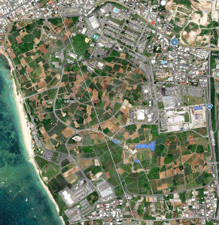
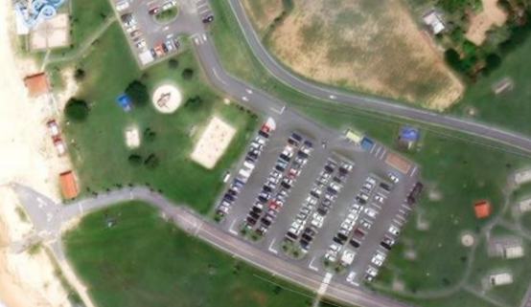
Concept of Operations for (Unit Name)
Event Name (DD MMM YYYY)
Phase 1: Set-up
Timeline: 0600-0900 Pavilion 1
COVID: All personnel will wear masks (list all measures)
Bounce house (or other equipment), handwash/sanitization stations and food areas set-up (clearly mark locations on map)
Phase 2: Execution
Timeline: 0900-1500 Pavilion 1
COVID: All personnel will wear masks and social distancing is enforced (list all measures)
Events ran (give timeline if multiple events)
Phase 3: Tear-down & Exfil
Timeline: 1500-1600 Pavilion 1
COVID: All personnel will wear masks (list all measures)
All equipment torn down and trash picked up.
Release and Exfil
Who: Unit Name
What: Event Type
When: DTG
Where: Exact Reserved Location
Why: Reason behind event
Risk Assessment Level: LOW/MEDIUM/HIGH
COVID Risk Level: LOW/MEDIUM/HIGH
(Justify Risk Levels in attached DRAW

Slide 6
Concept of Operations for (Unit Name)
Event Name (DD MMM YYYY)
Phase 1: Set-up
Timeline: 0600-0900 Pavilion 1
0600 Arrive
0630 Set-up Wash Stations (x3)
0700 Set-up Bounce House or whatever equipment is being used
0800 Set Food Areas
COVID: All personnel will wear masks (list all measures)
Bounce house (or other equipment), handwash/sanitization stations and food areas set-up (clearly mark locations on diagram)
Make this slide as detailed as possible with diagram and text descriptions. Use multiple slides for different phases as needed. Add distances between items to show social distancing in seating/dining areas.
Dunk Booth
Kids Games
Bounce House
Hand Wash Stations
Corn Hole
Pavilion
Tents
Risk Assessment Level: LOW/MEDIUM/HIGH
COVID Risk Level: LOW/MEDIUM/HIGH
(Justify Risk Levels in attached DRAW

